Slide 1
EXERCISE
5A: Design Challenges with 7 Step Canvas Framework
5
By Daniel Brouse UX2 / ICTE2002

Slide 2
COMMONWEALTH OF AUSTRALIA
Copyright Regulation 1969
WARNING
This material has been copied and communicated to you by or on behalf of Curtin University of Technology pursuant to Part VB of the Copyright Act 1968 (the Act)
The Material in this communication may be subject to copyright under the Act. Any further copying or communication of this material by you may be the subject of copyright protection under the Act.
Do not remove this notice.

Slide 3
5A: Design Challenges OBJECTIVE
In this exercise you'll be completing 3 design challenges using the 7 step framework canvas demonstrated in this week's lecture.

Slide 4
DESIGN CHALLENGE BRIEF - Prep
Your Tutor will assign you a design challenge brief (See Blackboard Study Topics > Week 5 > Design Challenge Briefs.docx)
Read through it, and familiarise yourself with the subject matter and audience
Each design challenge will take 30mins
Take your A2/A3 paper and divide it up into 7 section as per the example on the next slide …
1

Slide 5
1
2
3
4
5
6
7

Slide 6
Commence Step 1:
1. Why
Understand your goal
Why is this product or feature important? What problem are we trying to solve? What impact does it have on the world? How does this product benefit customers? What business opportunity does it create?
For existing products:
How it extends company’s mission?
+ all of the above
2

Slide 7
Commence Step 2:
2. Who
Define the audience
What are the categories of people who have significantly different motivations for using this product? Pick one.
What are the different groups inside this audience that have different needs?
Age, gender, location, occupation, mobility etc.
3

Slide 8
Commence Step 3:
3. When and Where
Understand customer's context and needs
List the context and conditions (When and Where)
Where are they physically?
Is there a trigger event causing this need? How much time do they have?
Are they on a specific digital app or platform? What emotions do they experience?
List customers needs
What is the customer’s high-level motivation for solving the problem?
How could they achieve that?
4

Slide 9
Commence Step 4:
4. What
List ideas (A, B, C...)
What could the company build to fulfill the customer’s needs?
Type of product: physical/digital
Smart watch, smartphone, tablet, desktop, laptop, TV, VR-headset etc.
Type of interface — graphic, audio/voice, VR, AR etc.
5

Slide 10
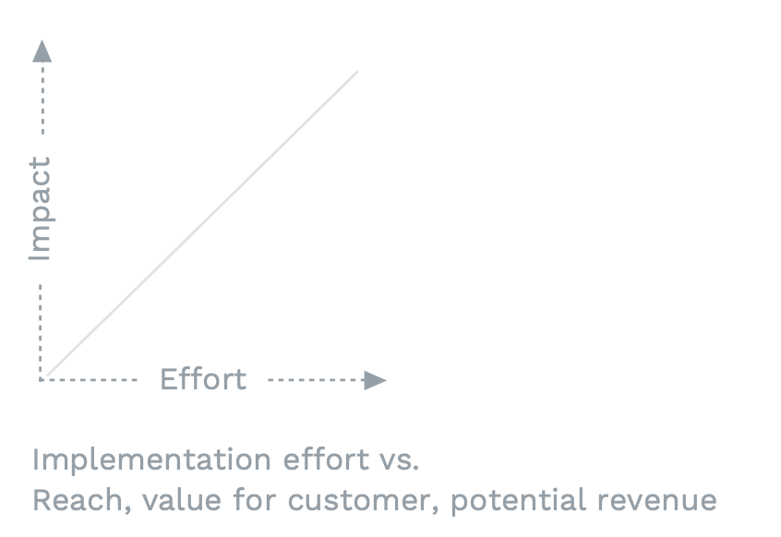
Commence Step 5:
5. Prioritise and choose an idea
Place ideas on an Impact/Effort matrix:
6

Slide 11
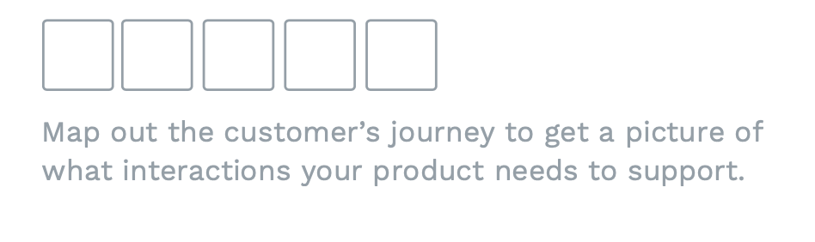
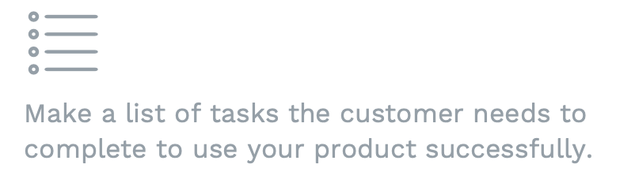
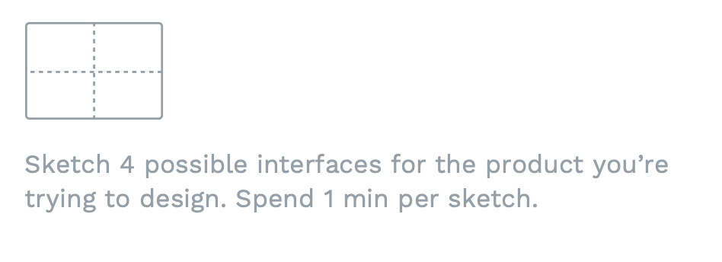
Commence Step 6:
6. Solve
Storyboarding
Defining Tasks
Speed Sketching
7

Slide 12
Commence Step 7:
4. How
Measure success
How would we know that the solution was successful?
Task success rate, task completion time, engagement, retention, revenue, conversion, user acquisition, net promoter score (NPS).
8

Slide 13
Repeat for the next two design challenges!
Each should take 30mins
9

Slide 14
End of Exercise

Slide 15
HOMEWORK
A2 work: Reflect on your 3 design challenges from exercise 5A, and choose your best one as the brief for your assessment 2. Based on your choice download the Full Client Brief from Blackboard (under Assessments > Assessment 2 > Full Client briefs), and begin some basic research on your given client.
A2 work: From your full client brief, begin ideation sketches for the 3 variations/concepts (part 1 of assessment 2). Remember to always keep the user in focus, as UX should take a user-centered-design approach.

Slide 16
Recommended reading / viewing
Complete Beginners Guide to UX Research https://www.uxbooth.com/articles/complete-beginners-guide-to-design-research/ What Is User Research, And What's Its Purpose? https://careerfoundry.com/en/blog/ux-design/the-importance-of-user-research-and-how-to-do-it/
10 of Today’s Biggest UX Challenges (And the Solutions to these Problems) https://justcreative.com/ux-problems-and-solutions/

